Slide 1

IOT BASED THIRD EYE FOR VISUALLY CHALLENGED PEOPLE

Slide 2
TEAM MEMBERS
MAADHAVAN U (22504167)
AARTHI K (22591780)
ABINAYA A (22591781)
AKASH V (22591784)
BARATH KRISHNAN N (22591785)
TILAK RAJ G (22591809)

Slide 3
AGENDA
Abstract
Introduction
Objective
Existing System
Disadvantages
Proposed System
Advantages
System requirements
Overall diagram
Modules

Slide 4
ABSTRACT
The third eye for blind is a device that helps blind people to navigate with speed and confidence by detecting the nearby obstacles.
Using the help of ultrasonic waves and notifying them with a buzzer sound and vibration.
They only need to wear this device as one of their accessories.

Slide 5
The vibration and buzzer occurs when the object comes at the distance of 1 meter thus it is a fully automated device.
At the noisy place, the blind is unable to hear the buzzer sound but the blind experiences a vibration due to the vibration module.
This enables the blind to navigate objects where there is a heavy traffic.

Slide 6
INTRODUCTION
This project helps the blind people to run their life as usual.
According to WHO, 39 million people are estimated as blind worldwide.
The affected ones have been using traditional white cane for many years which has many disadvantages.
The proposed system is more efficient way to help visually impaired people navigate with great comfort, speed and confidence

Slide 7
Our project consists of the spectacles which has ultrasonic sensors attached to it.
These ultrasonic sensors detect the nearby objects and alerts the blind person with the buzzer sound and vibrating wave signals.
The vibration helps the blind person to know about the presence of object in the noisy area.
This ensures the security of the blind person.

Slide 8
OBJECTIVE
The objective of project IoT based Third Eye For visually Challenged is
To design portable wearable device for the visually impaired and those who often must relay on others.
To help the visually impaired people to move around from one place to another with confidence.
To ensure the well being of the person by sending SOS message in case of emergency.

Slide 9
EXISTING SYSTEM
The major exiting systems are
White Cane
Vision (a torch for blinds)
Vibration Gloves

Slide 10
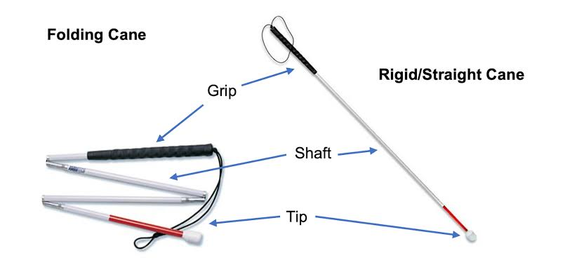
White Cane
It is a device used by many people who are blind or visually impaired.
It allows its users to scan their surroundings for obstacles.

Slide 11
Disadvantage
May crack or break easily
The stick may get stuck at the foot path cracks
Difficult to handle at crowded place
High chances for getting missed

Slide 12
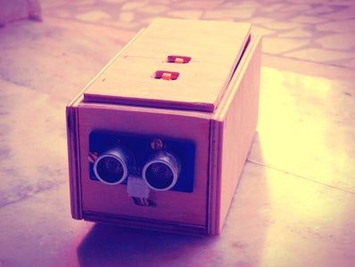
Vision
Vision is a smart device used is used by blind or visually impaired to navigate their path.
This uses ultrasonic waves to detect the obstacles and notify the user using a buzzer .
This idea was inspired from the bats, which use high frequency sound waves to move.

Slide 13
Disadvantage
Difficult to carry
Requires skill to use
High chances of getting dropped
Inconvenient to use

Slide 14
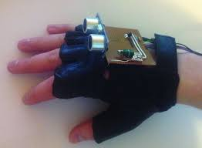
VIBRATION GLOVES
This system consists of a glove with a ultrasonic sensor
and vibration module .
The system this wore in the fist and requires the user
to raise his fist to detect the object
.
The ultrasonic sensor senses the nearby obstacles and
vibration is produced if an obstacle is present

Slide 15
Disadvantage
Difficult to handle
Difficult to perform other works wearing the gloves
May cause strain in the client hand
It can break when collide with other objects.

Slide 16
PROPOSED SYSTEM
In this system we are developing a navigation system for the blind persons.
This is very easy to use and work as a navigator to the blind people to easily navigate.
In this system the ultrasonic sensors will detect the object and gives beep sound and also sends vibration signals.
In the noisy area, the person may unable to hear the beep sound but still can feel the vibration.

Slide 17
The purpose of the project is to develop a product that is useful for blind people and people who often rely on others.
Visually impaired people move around and learn about nearby objects by using the portable armband holder that emits ultrasound, buzz when obstacles are detected.
The aim of the project is therefore to develop a cost-effective and efficient way to navigate more comfortably, faster and safer.

Slide 18
ADVANTAGES
It is portable and Economical
Small and light weight
Easy understandable mechanism.
Blind people navigate without the need of expensive tech or sticks.
It has the feature to detect the distance of objects.
Sending SOS message in case of any emergency.

Slide 19
SYSTEM REQUIREMENTS
HARDWARE REQUIREMENT:
ESP32
Ultrasonic Sensor
Vibration Module
Buzzer
Wires
Eye Glasses
GPS Module
SOFTWARE REQUIREMENT:
Operating System: Windows 10 or above
Platform : Arduino IDE
Programming Language : Embedded C
What’s App
Twilio API

Slide 20
SOFTWARE DESCRIPTION
The Arduino IDE is an open source software, which is used to write and upload code to the Arduino boards.
The IDE application is suitable for different operating systems such as Windows, MacOS, Linux.
It supports the programming languages C and C++.
The program or code written in the Arduino IDE is often called as sketching.
The sketch is saved with the extension “.ino “

Slide 21
OVERALL DIAGRAM

Slide 22
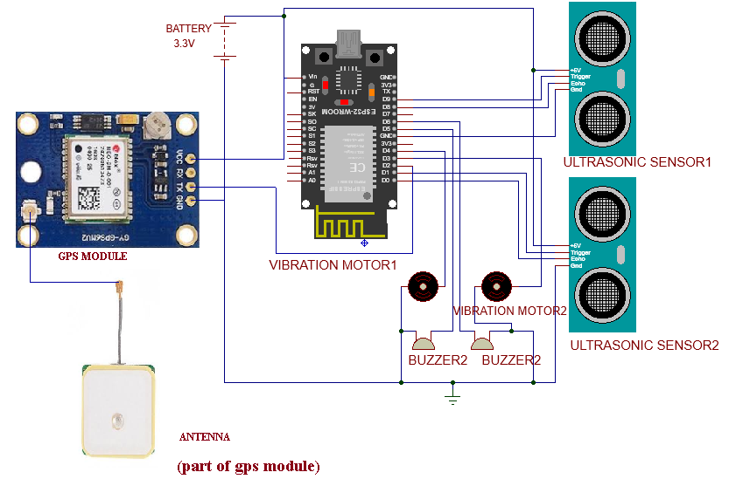

Slide 23
MODULES
There are three modules in our project
Object detection
Buzzer and vibrant notification
Sending SOS message through what’s app (in case of emergency)
MODULE DESCRIPTION :
Object detection:
In this module, the objects in the surrounding are detected by the ultrasonic sensors and those signals are sent to the micro controller.

Slide 24
The ultrasonic sensor consists of two parts
i)Trigger
ii)Echo
Trigger
It transmits ultrasonic waves which reflects back to the sensor on reaching the object.
Echo
It receives the ultrasonic waves deflected from the object reaches the Echo
The distance is calculated by
Distance/2

Slide 25
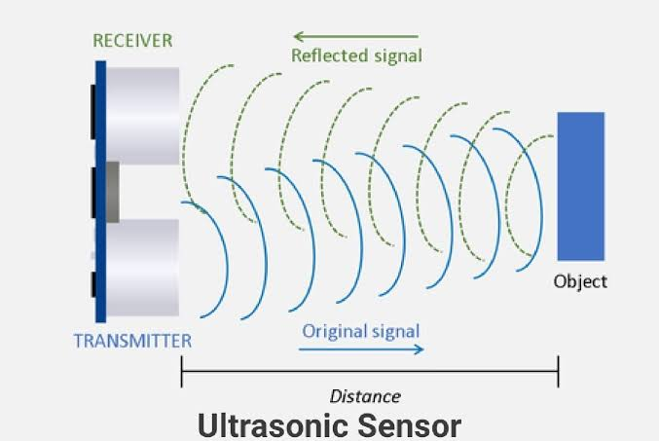
(Trigger)
(Echo)

Slide 26
Buzzer and vibrant notification:
The micro controller after receiving the signals from the sensor, the microcontroller makes the buzzer to buzz and vibration module to produce vibration.
Sending SOS message through what’s app (in case of emergency):
In case of emergency, the blind person clicks a button on the glass which sends a emergency message to the target what’s app through Twilio API.

Slide 27
THANK YOU !!!

